Slide 1
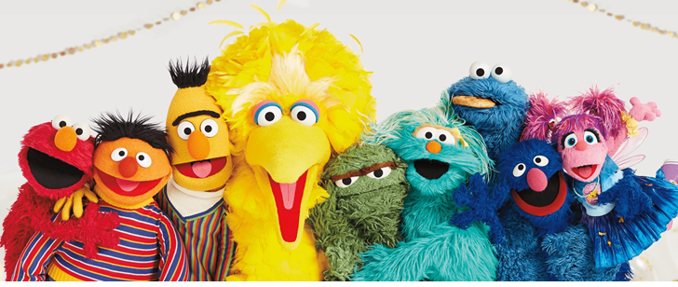
Self-Supervised Learning
https://www.sesameworkshop.org/what-we-do/sesame-streets-50th-anniversary
Hung-yi Lee 李宏毅
Notes:
Self-Supervised 的模型都是以芝麻街的人物命名

Slide 2

死臭酸宅本人
芝麻街

Slide 3

ERNIE (Enhanced Representation through Knowledge Integration)
Big Bird: Transformers for Longer Sequences
BERT (Bidirectional Encoder Representations from Transformers)
ELMo (Embeddings from Language Models)

Slide 4


BERT
Bertolt Hoover
340M
parameters
Source of image: https://leemeng.tw/attack_on_bert_transfer_learning_in_nlp.html
Notes:
貝爾托特·胡佛
Bertholdt Hoover

Slide 5
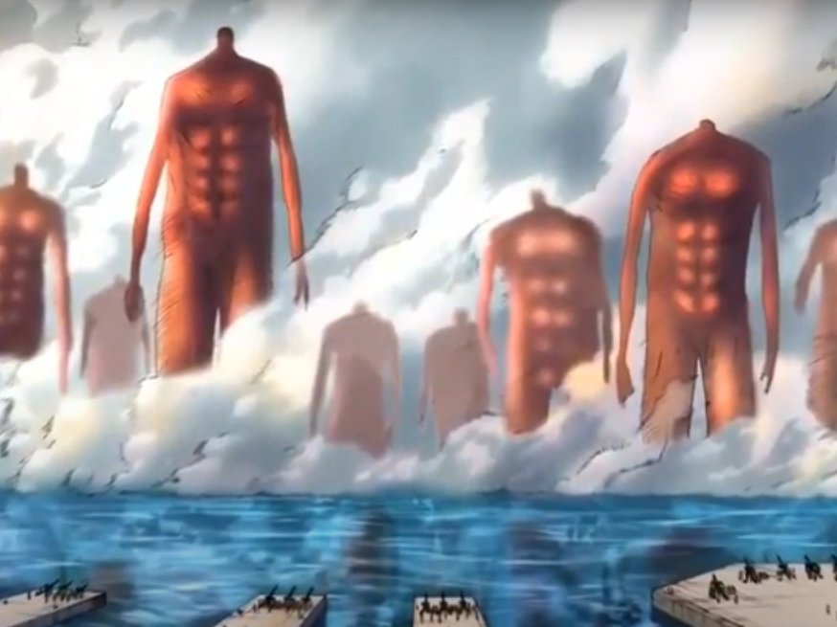
GPT-3
Source: https://youtu.be/wJJnjzNlMws
T5
GPT-2
BERT
ELMo

Slide 6
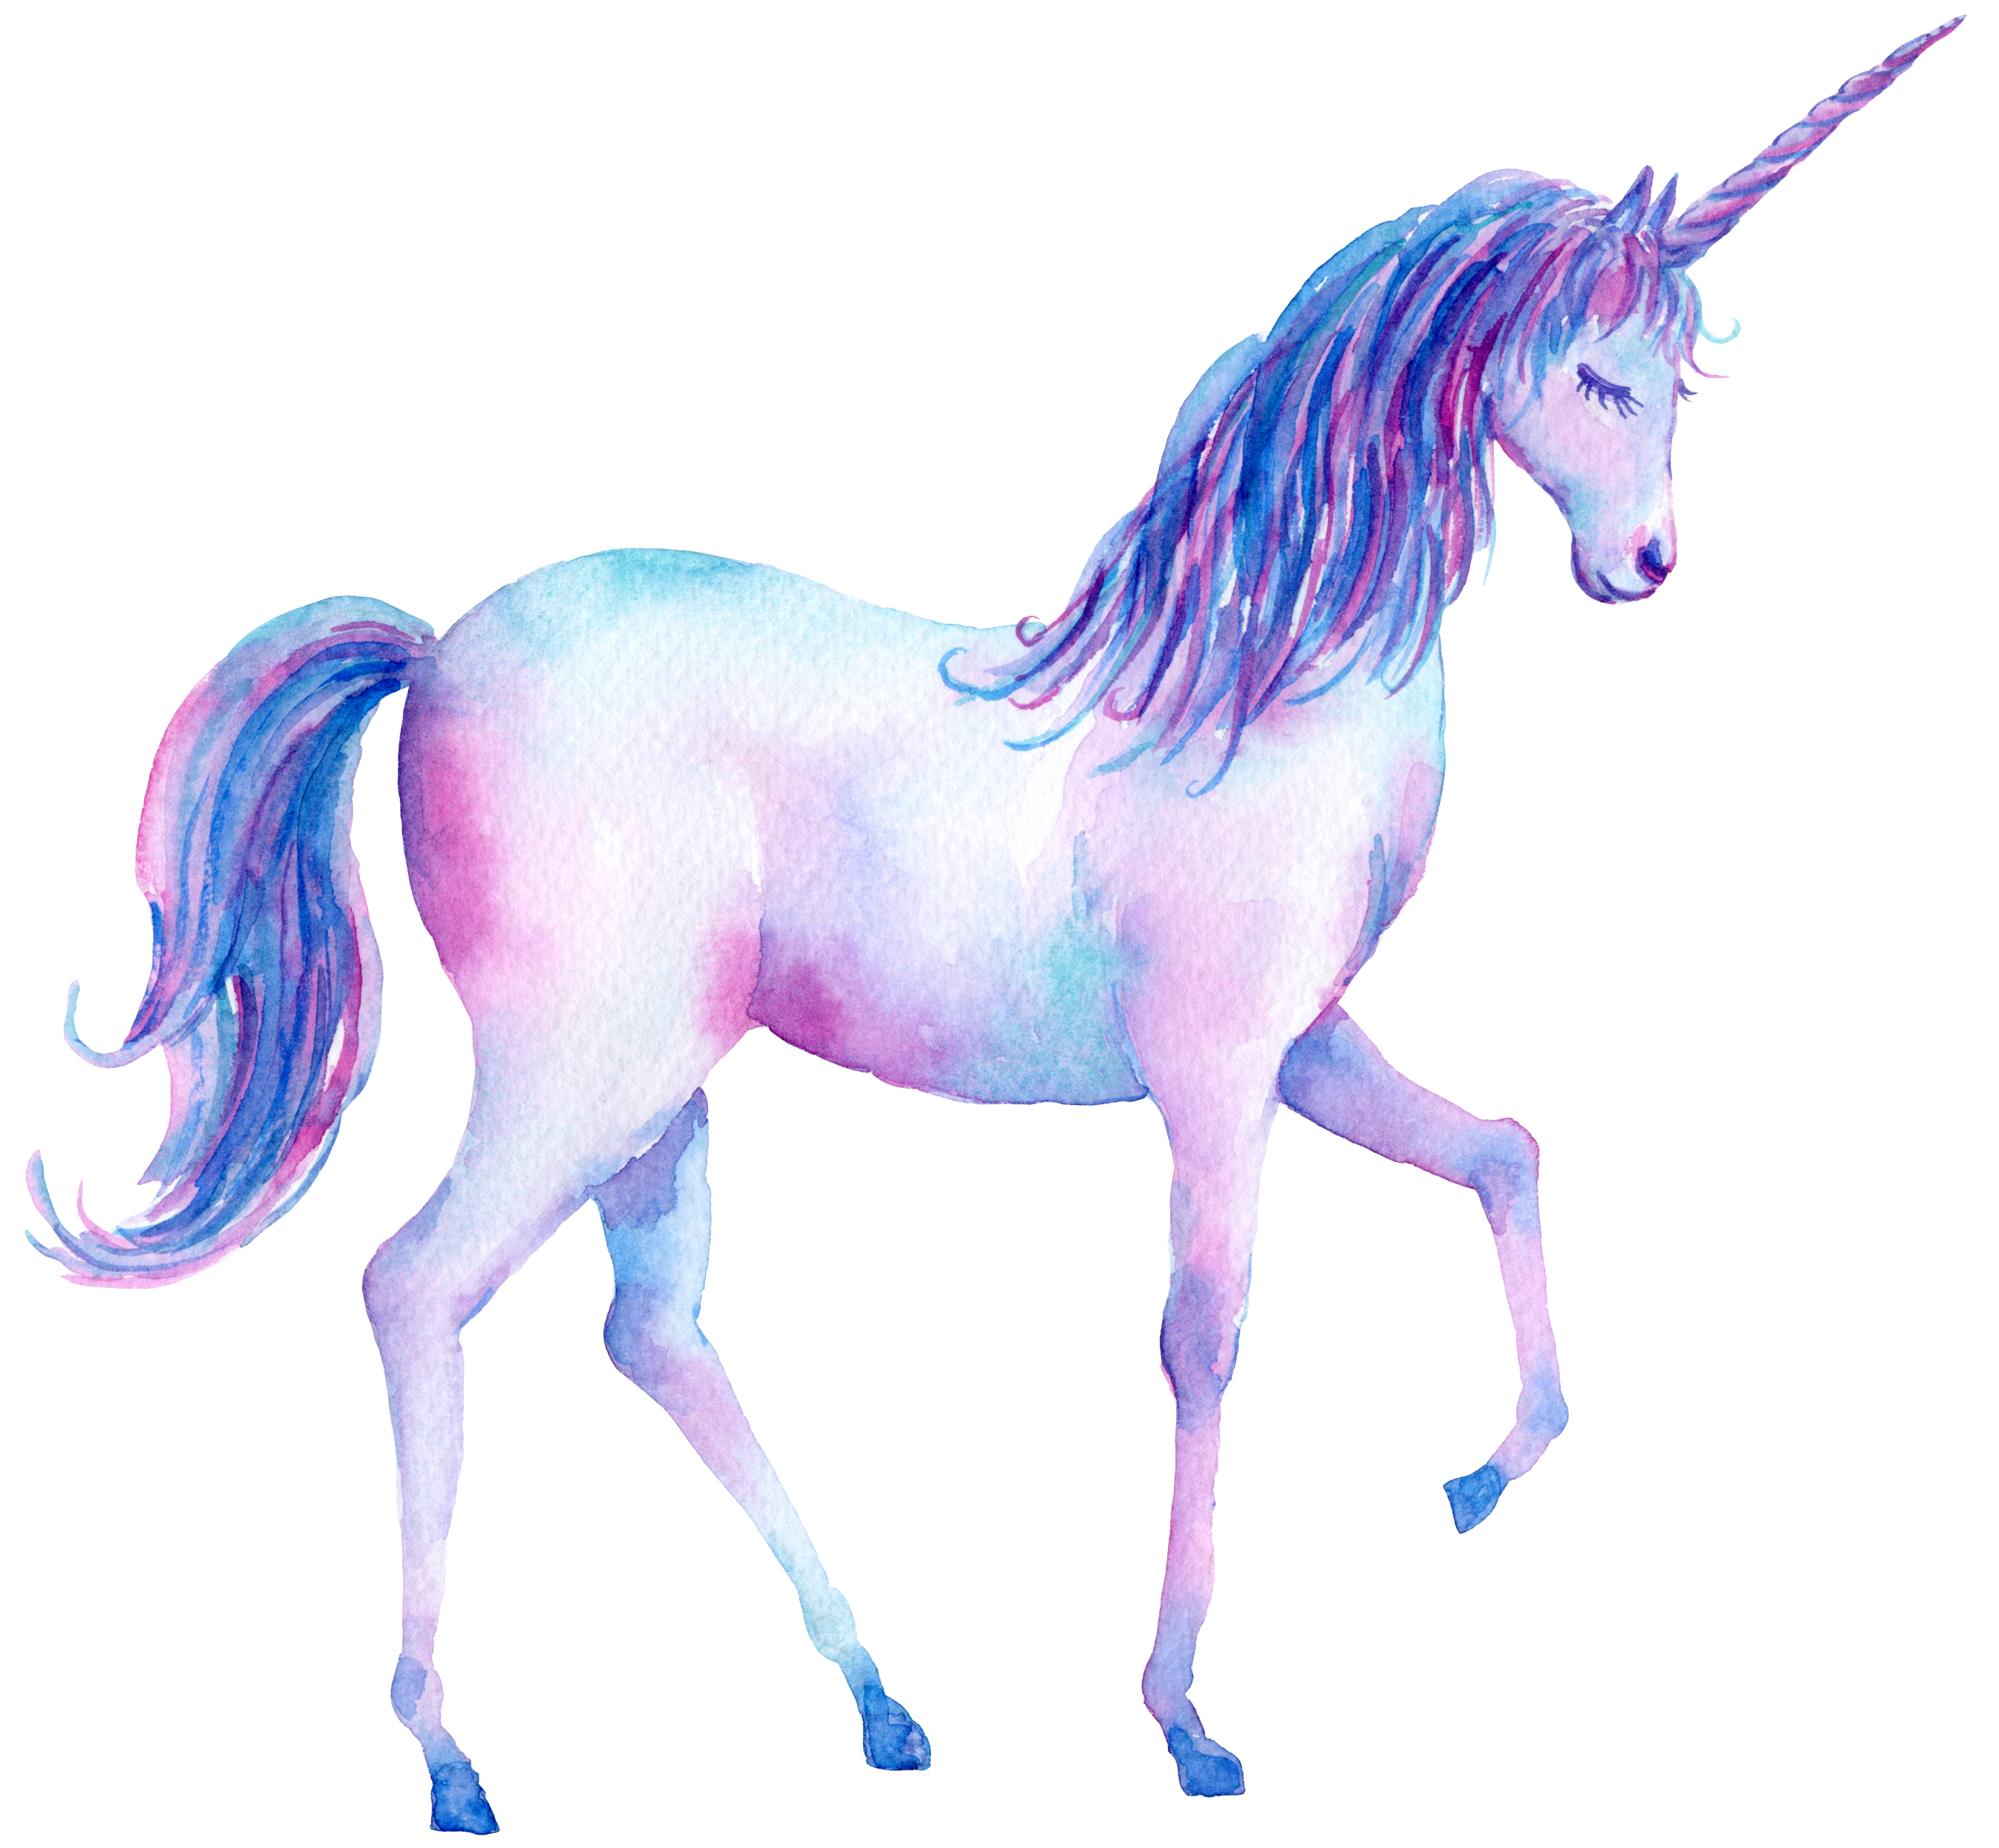
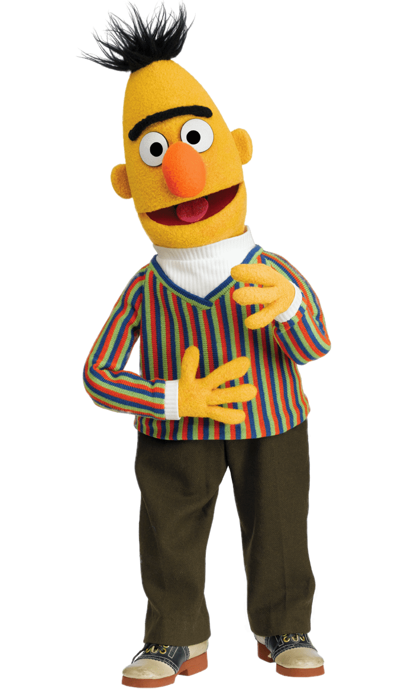

The models become larger and larger …
BERT (340M)
ELMO (94M)
GPT-2 (1542M)
Source of image: https://huaban.com/pins/1714071707/
Notes:
https://d4mucfpksywv.cloudfront.net/better-language-models/language_models_are_unsupervised_multitask_learners.pdf
93.6M
340M
1542M
40 GB

Slide 7

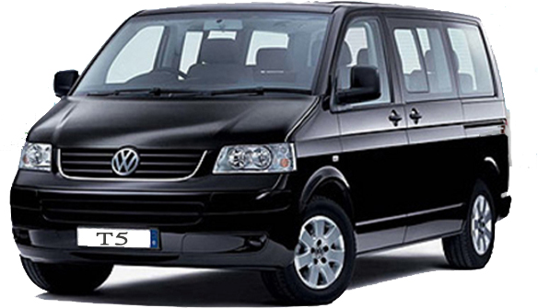
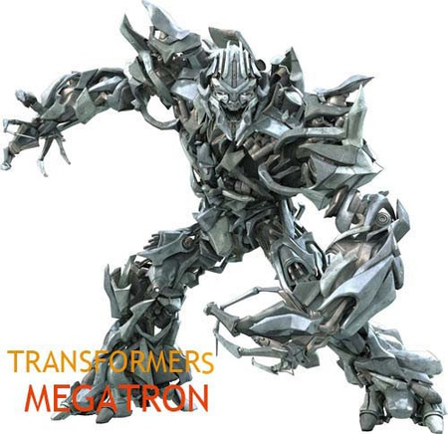
The models become larger and larger …
Turing NLG (17B)
GPT-3 is 10 times larger than Turing NLG.
GPT-2
Megatron (8B)
T5 (11B)

Slide 8
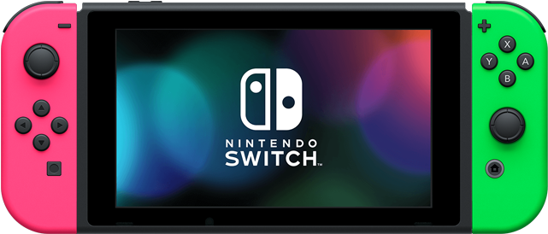
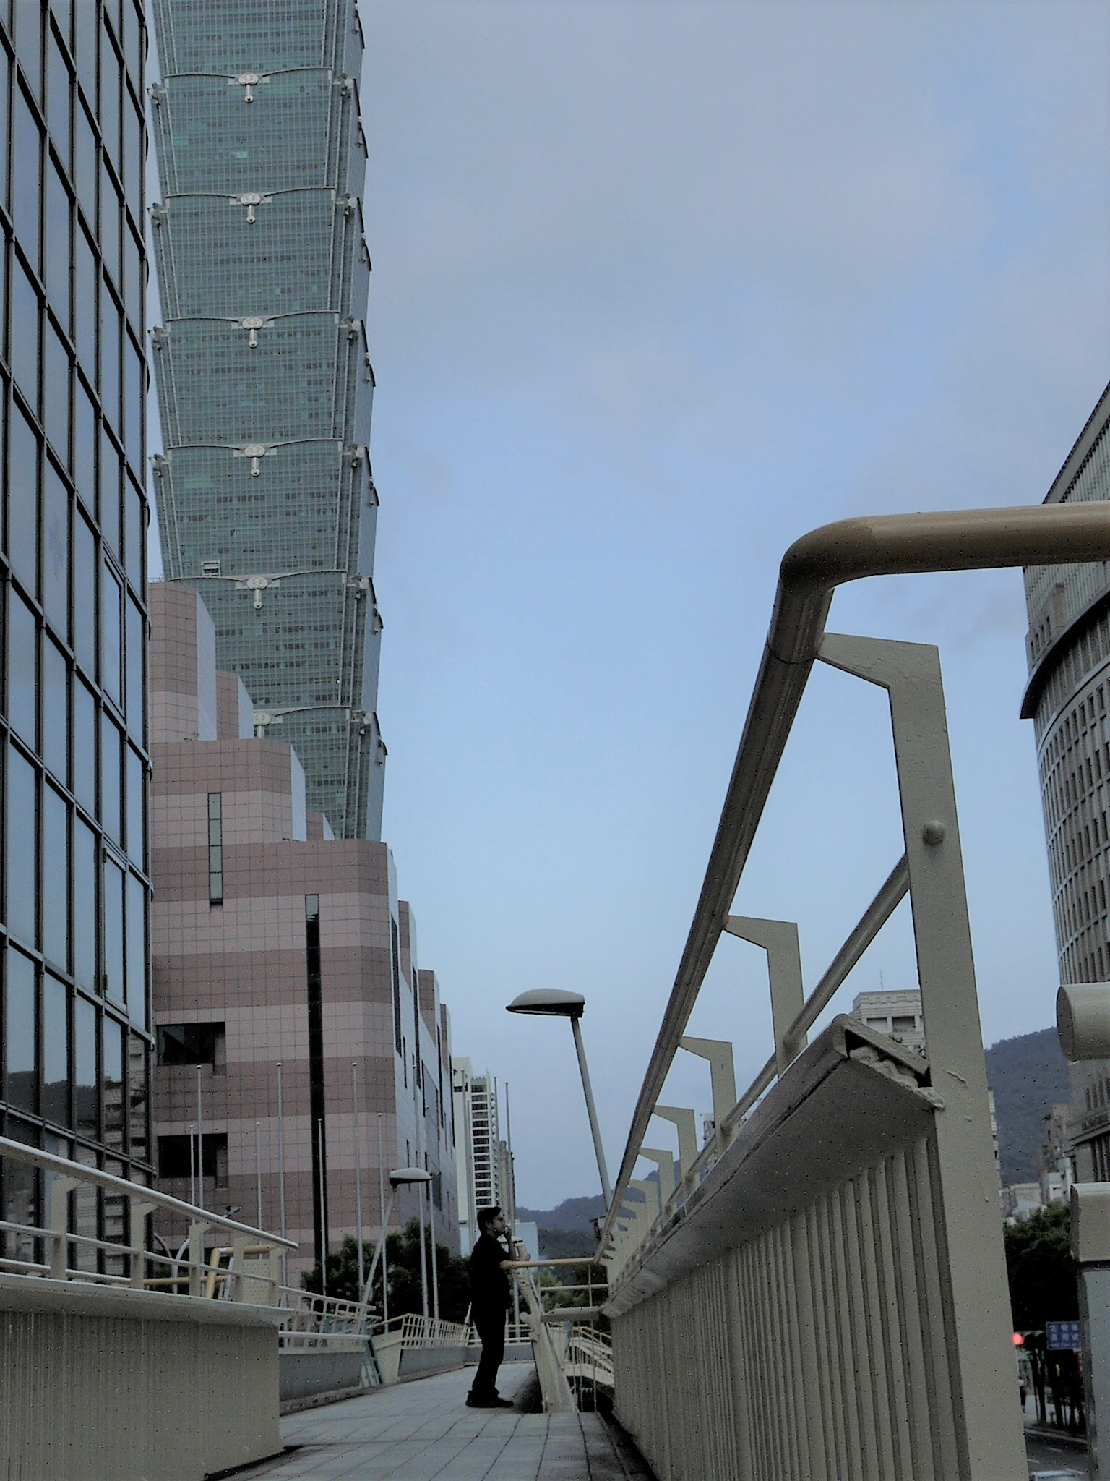
GPT-3
BERT (340M)
GPT-3 (175B)
Switch Transformer (1.6T)
死臭酸宅本人
BERT
https://arxiv.org/abs/2101.03961
Notes:
Switch! 比玉山高

Slide 9
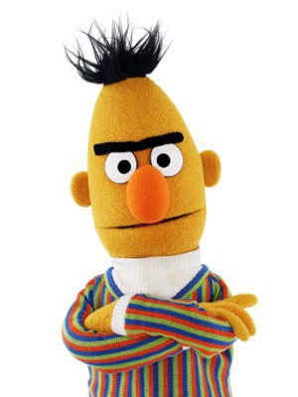
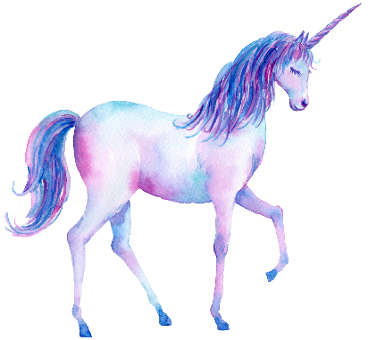
Outline
BERT series
GPT series

Slide 10

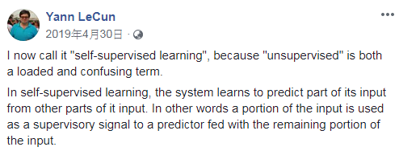
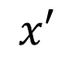
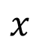
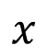
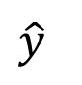
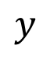
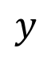
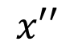
Self-supervised Learning
Self-supervised
Supervised
$$y$$
$$\hat{y}$$
$$y$$
$$x′′$$
label
Model
Model
$$x$$
$$x$$
$$x′$$

Slide 11
Masking Input
學 | 0.1
灣 | 0.7
台 | 0.1
大 | 0.1
…… | ……
https://arxiv.org/abs/1810.04805
softmax
=
(special token)
Linear
MASK
(all characters)
or
=
Random
一、天、大、小 …
Transformer
Encoder
BERT
Randomly masking some tokens
台
灣
大
學
Notes:
bert 是使用 Self-supervised Learning 方法训练出来的，具体来说有两种方法
1、Masking Input
2、Next Sentence Prediction
其中 Masking Input 相当于做填空题
Next Sentence Prediction 用于判断两个句子是否是连在一起的

Slide 12
Masking Input
Ground truth
https://arxiv.org/abs/1810.04805
minimize cross entropy
softmax
灣
=
(special token)
Linear
MASK
or
=
Random
一、天、大、小 …
Transformer
Encoder
BERT
Randomly masking some tokens
台
灣
大
學

Slide 13
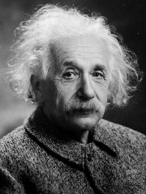
Next Sentence Prediction
This approach is not helpful.
Linear
Robustly optimized BERT approach (RoBERTa)
Yes/No
https://arxiv.org/abs/1907.11692
SOP: Sentence order prediction
Used in ALBERT
https://arxiv.org/abs/1909.11942
BERT
[CLS]
w₁
w₂
[SEP]
w₃
w₄
w₅
Sentence 1
Sentence 2
Notes:
bert 是使用 Self-supervised Learning 方法训练出来的，具体来说有两种方法
1、Masking Input
2、Next Sentence Prediction
其中 Masking Input 相当于做填空题
Next Sentence Prediction 用于判断两个句子是否是连在一起的
[CLS] stands for classification.

Slide 14

BERT
Self-supervised Learning
Masked token prediction
Next sentence prediction
Pre-train
Fine-tune
Model for Task 1
Model for Task 2
Model for Task 3
Downstream Tasks
The tasks we care
We have a little bit labeled data.
Notes:
bert 模型训练出来以后到底该有什么用了，到底该怎么用了
Downstream Tasks : the task you really want to solve 下游任务：你真正想要解决的任务
Better than directly using labeld data 比直接使用标记数据更好
bert 做下游任务就是说，bert 本身会做填空题了，有了做填空题的能力
再进行微调之后就可以做各种各样的任务了

Slide 15
GLUE
General Language Understanding Evaluation (GLUE)
https://gluebenchmark.com/
Corpus of Linguistic Acceptability (CoLA)
Stanford Sentiment Treebank (SST-2)
Microsoft Research Paraphrase Corpus (MRPC)
Quora Question Pairs (QQP)
Semantic Textual Similarity Benchmark (STS-B)
Multi-Genre Natural Language Inference (MNLI)
Question-answering NLI (QNLI)
Recognizing Textual Entailment (RTE)
Winograd NLI (WNLI)
GLUE also has Chinese version (https://www.cluebenchmarks.com/)
Notes:
General Language Understanding Evaluation (GLUE) 一般语言理解评估（GLUE）
Corpus of Linguistic Acceptability (CoLA) 语言可接受性语料库
Stanford Sentiment Treebank (SST-2) 斯坦福情感树库（SST-2）
Microsoft Research Paraphrase Corpus (MRPC) 微软研究释义语料库（MRPC）
Quora Question Pairs (QQP) Quora问题对（QQP）
Semantic Textual Similarity Benchmark (STS-B) 语义文本相似基准（STS-B）
Multi-Genre Natural Language Inference (MNLI) 多体裁自然语言推理
Question-answering NLI (QNLI) 问答式NLI （QNLI）
Recognizing Textual Entailment (RTE) 识别文本蕴涵（RTE）
Winograd NLI (WNLI) Winograd NLI （WNLI）
COLA: Each example is a sequence of words annotated with whether it is a grammatical English sentence
COLA：每个例子都是一个单词序列，并注释它是否是一个合乎语法的英语句子
MRPC: with human annotations for whether the sentences in the pair are semantically equivalent
MRPC：对句子对中的句子是否语义等价进行人工注释
QQP:o determine whether a pair of questions are semantically equivalent.
确定一对问题在语义上是否等价。
STS: Each pair is human-annotated with a similarity score from 1 to 5; the task is to predict these scores
STS：对每一对进行人工注释，相似度评分从1到5；任务是预测这些分数

Slide 16
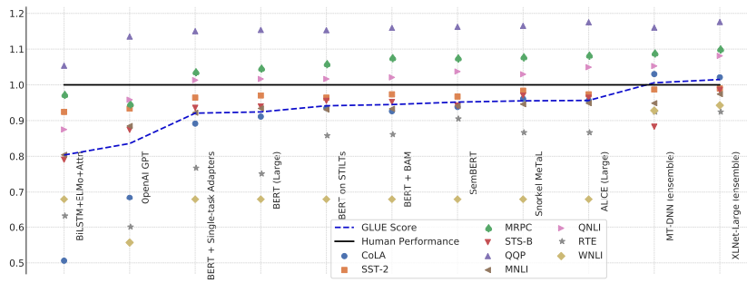
BERT and its Family
GLUE scores
Source of image: https://arxiv.org/abs/1905.00537

Slide 17
How to use BERT – Case 1
class
Input: sequence
output: class
Linear
Random initialization
Example:
Sentiment analysis
Better than random
this is good
Init by pre-train
BERT
positive
This is the model to be learned.
[CLS]
w₁
w₂
w₃
sentence
Notes:
sentence 构成的 W1 W2 W3 都会产生输出，但我们只需要 [CLS] 对应的输出即可
Do I have to mention adaptor??? 我必须提到适配器吗？？
(https://arxiv.org/abs/1805.12471)
半监督学习

Slide 18
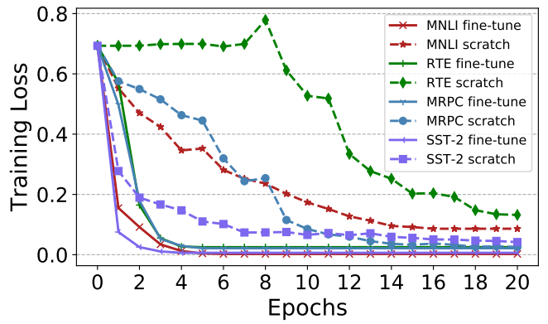
Pre-train v.s. Random Initialization
(fine-tune)
(scratch)
Source of image: https://arxiv.org/abs/1908.05620

Slide 19


Slide 20
How to use BERT – Case 2
class
class
class
Input: sequence
output: same as input
Linear
Linear
Linear
Example:
POS tagging
I saw a saw
BERT
N
V
DET
N
[CLS]
w₁
w₂
w₃
sentence
Notes:
(https://arxiv.org/abs/1805.12471)

Slide 21
How to use BERT – Case 3
Input: two sequences
Output: a class
Example:
Natural Language Inferencee (NLI)
contradiction
entailment
neutral
premise: A person on a horse jumps over a broken down airplane
Model
hypothesis: A person is at a diner.
contradiction
Notes:
premise: A person on a horse jumps over a broken down airplane 前提：一个人骑着马跳过一架坏了的飞机
hypothesis: A person is at a diner. 假设：一个人在吃晚餐。
这种 case 可以用于 立场分析，比如发表了一篇文章，有人在文章下留言
将文章和留言输入到 model 中，输出这个人的立场(赞成还是反对 )

Slide 22
How to use BERT – Case 3
Class
Input: two sequences
Output: a class
Linear
BERT
[CLS]
w₁
w₂
[SEP]
w₃
w₄
w₅
Sentence 1
Sentence 2

Slide 23
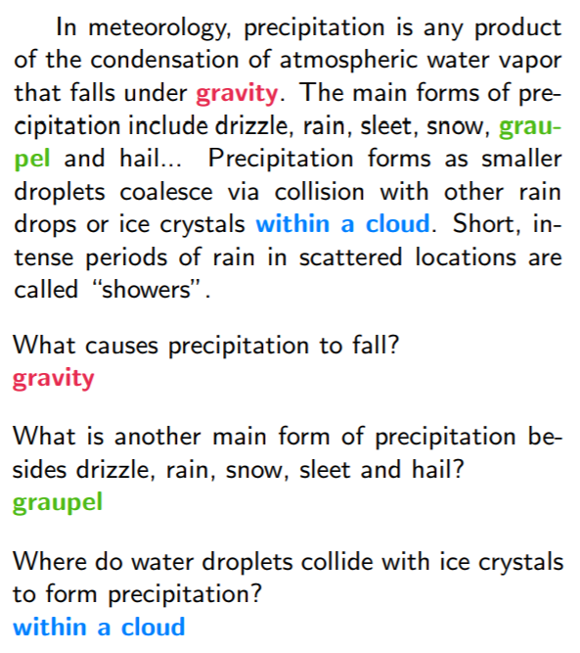
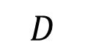

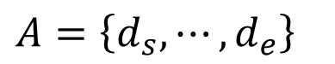

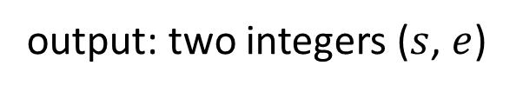
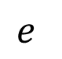
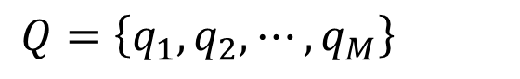
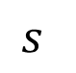
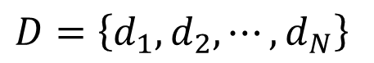
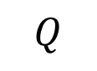
How to use BERT – Case 4
Extraction-based Question Answering (QA)
17
Document:
$$D=\left\{d_{1},d_{2},⋯,d_{N}\right\}$$
Query:
$$Q=\left\{q_{1},q_{2},⋯,q_{M}\right\}$$
77
79
$$D$$
QA
Model
$$s$$
$$e$$
$$s=17,e=17$$
$$Q$$
output: two integers ($s$, $e$)
Answer:
$$A=\left\{d_{s}, ⋯,d_{e}\right\}$$
$$s=77,e=79$$
Notes:
Extraction-based Question Answering (QA)
这种问答相对一般问答来说不同点是答案一般出现在文章中
相关数据 (E.g. SQuAD)

Slide 24
How to use BERT – Case 4
Random Initialized
0.3
0.5
0.2
s = 2
Softmax
inner product
BERT
[CLS]
q₁
q₂
[SEP]
d₁
d₂
d₃
question
document

Slide 25
How to use BERT – Case 4
Random Initialized
0.1
0.2
0.7
s = 2
e = 3
Softmax
The answer is “d₂ d₃”.
inner product
BERT
[CLS]
q₁
q₂
[SEP]
d₁
d₂
d₃
question
document
Notes:
四个 case 和 bert 做填空题有什么关系

Slide 26

That is all about BERT!

Slide 27
Training BERT is challenging!
台達電產學合作計畫研究成果
This work is done by 姜成翰
Training data has more than 3 billions of words.
3000 times of Harry Potter series
Google’s ALBERT-base
Google’s BERT-base
Our ALBERT-base
https://arxiv.org/abs/2010.02480
8 days with TPU v3
GLUE scores

Slide 28
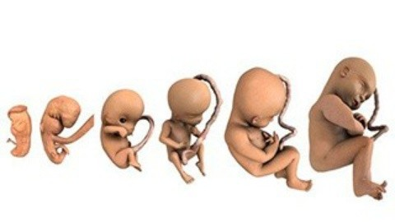
BERT Embryology (胚胎學)
https://arxiv.org/abs/2010.02480
When does BERT know POS tagging, syntactic parsing, semantics?
The answer is counterintuitive!

Slide 29
Pre-training a seq2seq model
Reconstruct the input
w₁
w₂
w₃
w₄
w₅
w₆
w₇
w₈
Cross Attention
Encoder
Decoder
w₁
w₂
w₃
w₄
Corrupted

Slide 30
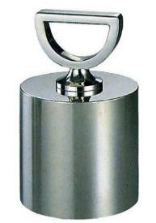

MASS / BART
MASS
A B [SEP] C D E
A B [SEP] C E
BART
(Delete “D”)
A B [SEP] C D E
C D E [SEP] A B
(permutation)
D E A B [SEP] C
(rotation)
https://arxiv.org/abs/1905.02450
https://arxiv.org/abs/1910.13461
A B [SEP] E
Text Infilling

Slide 31

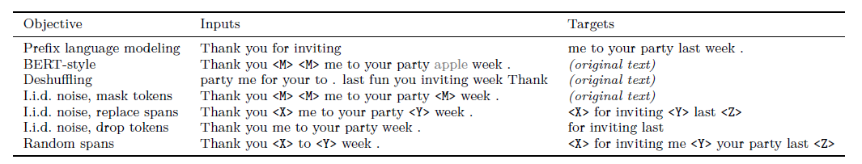
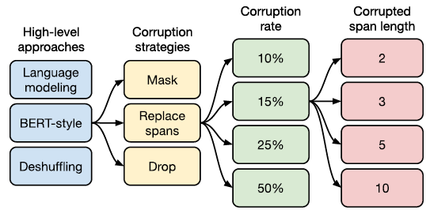
T5 – Comparison
Transfer Text-to-Text Transformer (T5)
Colossal Clean Crawled Corpus (C4)

Slide 32
Why does BERT work?
Represent the meaning of “大”
The tokens with similar meaning have similar embedding.
embedding
草
吃蘋
果
鳥
BERT
魚
電
蘋果手機
台
灣
大
學
Context is considered.
Notes:
为什么 bert 可以做到上述任务

Slide 33
Why does BERT work?
compute cosine similarity
BERT
BERT
喝
蘋
果
汁
蘋
果
電
腦

Slide 34
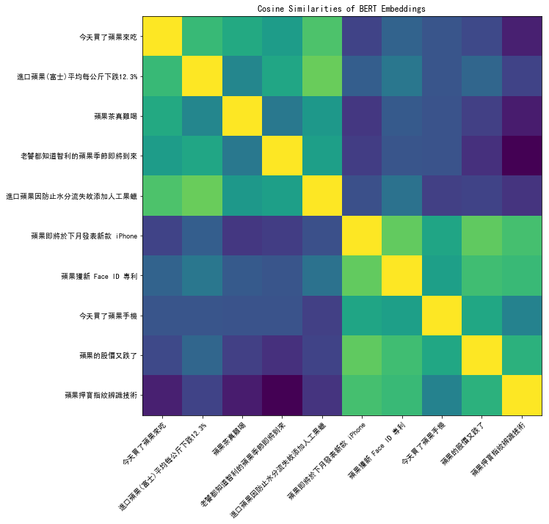
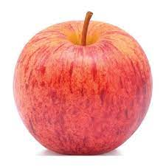

Notes:
https://colab.research.google.com/drive/1mWOWFdmI_f18Vo2HpxaVrauzlnAAWw2C

Slide 35
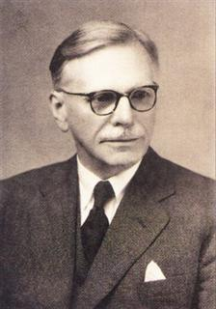
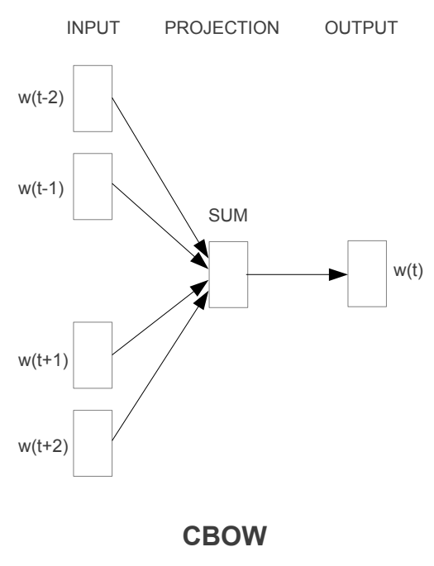
Why does BERT work?
You shall know a word by the company it keeps
Contextualized word embedding
w₂
John Rupert Firth
BERT
word embedding
w₁
w₂
w₃
w₄

Slide 36
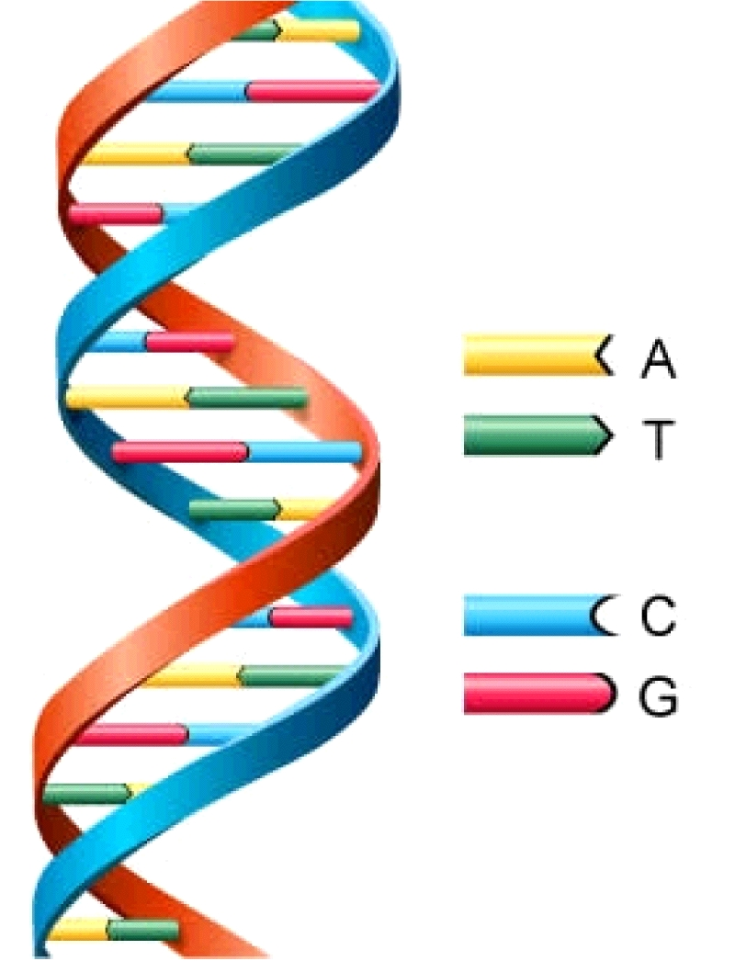
Why does BERT work?
https://arxiv.org/abs/2103.07162
This work is done by 高瑋聰
Applying BERT to protein, DNA, music classification
EI CCAGCTGCATCACAGGAGGCCAG
EI AGACCCGCCGGGAGGCGGAGGA
IE AACGTGGCCTCCTTGTGCCCTTCC
IE CCACTCAGCCAGGCCCTTCTTCTC
IE CCTGATCTGGGTCTCCCCTCCCAC
IE AGCCCTCAACCCTTCTGTCTCACC
IE CCACTCAGCCAGGCCCTTCTTCTC
N CTGTGTTCACCACATCAAGCGCCG
N GTGTTACCGAGGGCATTTCTAACA
N TCTGAGCTCTGCATTTGTCTATTCT
class
DNA sequence

Slide 37
Why does BERT work?
https://arxiv.org/abs/2103.07162
This work is done by 高瑋聰
class
Linear
Random initialization
pre-train on English
Init by pre-train
A | we
T | you
C | he
G | she
BERT
[CLS]
we
she
we
he
DNA sequence
A
G
A
C

Slide 38
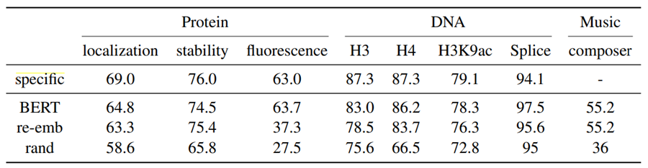

Why does BERT work?
https://arxiv.org/abs/2103.07162
This work is done by 高瑋聰
Applying BERT to protein, DNA, music classification

Slide 39


To Learn More ……
BERT (Part 1)
BERT (Part 2)
https://youtu.be/1_gRK9EIQpc
https://youtu.be/Bywo7m6ySlk

Slide 40
Multi-lingual BERT
Multi-BERT
Multi-BERT
high
est
Mask
Mask
moun
tain
深
度
學
習
Training a BERT model by many different languages.
Notes:
You have an universal token set for all languages. 您有一个适用于所有语言的通用标记集。

Slide 41
Zero-shot Reading Comprehension
Training on the sentences of 104 languages
Doc1
Query1
Ans1
Doc2
Query2
Ans2
Doc1
Query1
?
Doc3
Query3
Ans3
Doc3
Query3
?
Doc4
Query4
Ans4
Doc5
Query5
Ans5
Doc2
Query2
?
Train on English QA training examples
Test on Chinese
QA test
Multi-BERT
Notes:
Beto, Bentz, Becas: The Surprising Cross-Lingual Effectiveness of BERT
https://arxiv.org/abs/1904.09077

Slide 42
Zero-shot Reading Comprehension
English: SQuAD, Chinese: DRCD
Model | Pre-train | Fine-tune | Test | EM | F1
QANet | none | Chinese | Chinese | 66.1 | 78.1
BERT | Chinese | Chinese |  | 82.0 | 89.1
 | 104 languages | Chinese |  | 81.2 | 88.7
 |  | English |  | 63.3 | 78.8
 |  | Chinese + English |  | 82.6 | 90.1
F1 score of Human performance is 93.30%
This work is done by 劉記良、許宗嫄
https://arxiv.org/abs/1909.09587

Slide 43

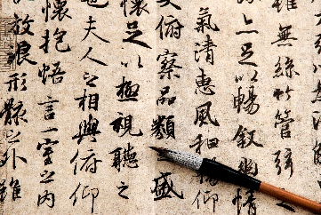
Cross-lingual Alignment?
跳
jump
游
兔
Multi-BERT
swim
rabbit
魚
fish
深
度
學
習
high
est
moun
tain
Notes:
原因可能是，bert 只关心词汇的含义，不关心词汇是什么语言
不同语言但是具有相同含义的词汇输入到 bert 模型中输出是一样的
https://www.youtube.com/watch?v=8rDN1jUI82g

Slide 44
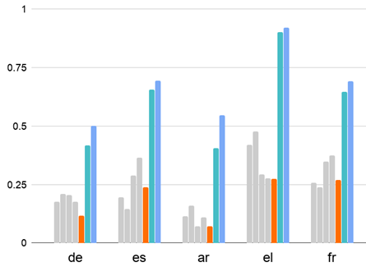
Mean Reciprocal Rank (MRR):
Higher MRR, better alignment
Google’s Multi-BERT
Our Multi-BERT
200k sentences for each lang
https://arxiv.org/abs/2010.10938
How about 1000k?
投影片來源: 許宗嫄同學碩士口試投影片

Slide 45
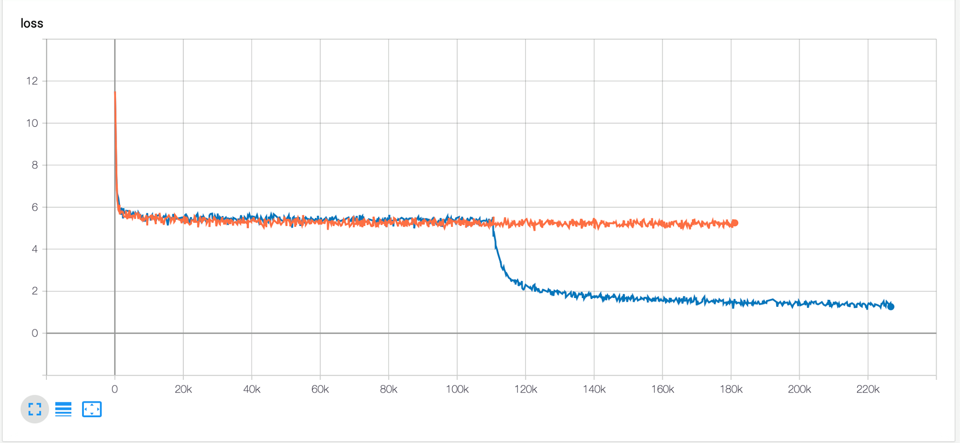
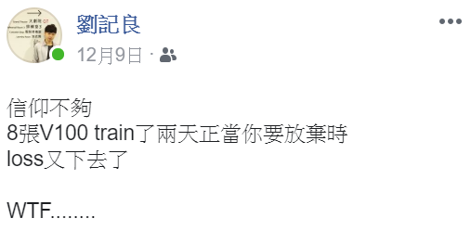
The training is also challenging …
Two days ……
(the whole training took one week)

Slide 46
Mean Reciprocal Rank (MRR):
Higher MRR, better alignment
The amount of training data is critical for alignment.
Google’s Multi-BERT
Our Multi-BERT
1000k sentences
Our Multi-BERT
200k sentences for each lang
https://arxiv.org/abs/2010.10938
投影片來源: 許宗嫄同學碩士口試投影片

Slide 47
https://arxiv.org/abs/2010.10041
Weird???
深
度
學
習
high
est
moun
tain
跳
jump
游
Reconstruction
兔
swim
rabbit
魚
fish
If the embedding is language independent …
Multi-BERT
How to correctly reconstruct?
There must be language information.
深
度
學
習
high
est
moun
tain

Slide 48
This work is done by 劉記良、許宗嫄、莊永松
Where is Language?
那
有
一
貓
跳
jump
Reconstruction
游
兔
swim
rabbit
魚
+
+
+
+
fish
Average of Chinese
Multi-BERT
Average of English
there
is
a
cat

Slide 49
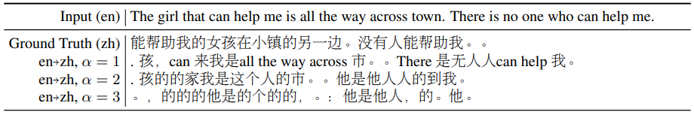
This work is done by 劉記良、許宗嫄、莊永松
If this is true …
https://arxiv.org/abs/2010.10041
跳
jump
Average of Chinese
游
兔
swim
$α$x
rabbit
魚
Average of English
fish
Unsupervised token-level translation ☺

Slide 50
Outline
BERT series
GPT series

Slide 51
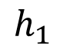
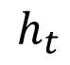
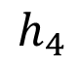
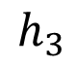
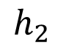
Predict Next Token
w_{t+1}
Training data: “台灣大學”
台
灣
大
學
Cross entropy
?
?
?
?
softmax
$$h_{1}$$
$$h_{2}$$
$$h_{3}$$
$$h_{4}$$
Linear
Transform
Model
from w_{t}
$$h_{t}$$
<BOS>
台
灣
大
Notes:
gpt model 类似 transformer decoder
使用 masked self attention
https://arxiv.org/abs/1802.05365
但是 gpt 系列模型的具体结构是不知道的，只知道他能预测下一个词，也就是有生成的能力
那么该如何应用这种生成能力了

Slide 52

Predict Next Token
https://talktotransformer.com/
They can do generation.
Notes:
gpt model 类似 transformer decoder
使用 masked self attention
https://arxiv.org/abs/1802.05365
但是 gpt 系列模型的具体结构是不知道的，只知道他能预测下一个词，也就是有生成的能力
那么该如何应用这种生成能力了

Slide 53


How to use GPT?
Description
A few example
Notes:
gpt model 类似 transformer decoder
使用 masked self attention
https://arxiv.org/abs/1802.05365
但是 gpt 系列模型的具体结构是不知道的，只知道他能预测下一个词，也就是有生成的能力
那么该如何应用这种生成能力了

Slide 54
“Few-shot” Learning
(no gradient descent)
“One-shot” Learning
“Zero-shot” Learning
“In-context” Learning

Slide 55

Average of 42 tasks

Slide 56

To learn more ……
https://youtu.be/DOG1L9lvsDY
Notes:
Self-supervised Learning: (or semi-supervied learning )
Good ref: https://lilianweng.github.io/lil-log/2019/11/10/self-supervised-learning.html
Scenario
Application: text, image, audio
Pretext:
Contrastive
SimCLR,
MoCo
Comparison of different approaches: https://arxiv.org/pdf/2011.10566v1.pdf
No negative - BOYL
Why it work: https://www.untitled-ai.com/understanding-self-supervised-contrastive-learning.html
Prediction
Reconstruction
Teacher / Student
Self-training with Noisy Student improves ImageNet classification
Billion-scale semi-supervised learning for image classification
Self-training v.s. Self-supervied learning
https://medium.com/%E8%BB%9F%E9%AB%94%E4%B9%8B%E5%BF%83/deep-learning-self-training%E7%95%B6%E9%81%93-%E5%B0%8D%E6%AF%94pre-training%E7%9A%84%E5%84%AA%E7%BC%BA%E9%BB%9E-4f1b5a937c5d
Other task:
Unsupervised Representation Learning by Predicting Image Rotations https://arxiv.org/pdf/1803.07728.pdf
Unsupervised Learning of Visual Representations by Solving Jigsaw Puzzles https://arxiv.org/abs/1603.09246
Tracking Emerges by Colorizing Videos
Weird thing:
https://research.aimultiple.com/self-supervised-learning/

Slide 57
Beyond Text
NLP
Speech
CV
Data Centric
Prediction
Contrastive
Position, 2015
RNNLM, 1997
APC, 2019
InfoNCE, 2017
CPC, 2019
Jigsaw, 2017
word2v, 2013
audio2v, 2019
SimCLR, 2020
MoCo, 2019
Rotation, 2018
Cutout, 2015
BERT, 2018
Mock, 2020
MoCov2, 2020
TERA, 2020
BYOL, 2020
本投影片由劉廷緯同學提供
SimSiam, 2020
Notes:
Self-supervised Learning 在其他领域的应用

Slide 58


Image - SimCLR
https://arxiv.org/abs/2002.05709
https://github.com/google-research/simclr

Slide 59

Image - BYOL
Bootstrap your own latent:
A new approach to self-supervised Learning
https://arxiv.org/abs/2006.07733

Slide 60


Speech
BERT
Audio version
深
度
學
習
Notes:
http://superbbenchmark.org/

Slide 61
Speech GLUE - SUPERB
Speech processing Universal PERformance Benchmark
Will be available soon
Downstream: Benchmark with 10+ tasks
The models need to know how to process content, speaker, emotion, and even semantics.
Toolkit: A flexible and modularized framework for self-supervised speech models.
https://github.com/s3prl/s3prl

Slide 62

https://github.com/andi611/Self-Supervised-Speech-Pretraining-and-Representation-Learning
Notes:
self-supervised speech

Slide 63
Appendix
(a joke)

Slide 64

Predict Next Token
They can do generation.
Notes:
https://talktotransformer.com/
https://disp.cc/b/115-bC2b

Slide 65

律師
Notes:
əˈtərnē

Slide 66

混亂
Notes:
ˈanərkē

Slide 67



I forced a bot to watch over 1,000 hours of XXX
是一個梗!
人在模仿機器模仿人!!!

